Slide 1
DEFECT LIFE CYCLE

Slide 2
Defect life cycle
Learning Objectives :
Understanding Defect
Severity and Priority
Format of Defect Report
Defect Management
Defect lifecycle
Types of Defect

Slide 3
What is defect?
“ Missing, Wrong, Not expected in the software which is difficult to understand, hard to use is called as Defect”.
“A software error is present when the program does not do what product specification states it should do”.

Slide 4



Error-Fault(defect)-failure
A person makes an error ...
… that creates a fault in the software ...
… that can cause
a failure
in operation

Slide 5
Who can report defect?
Anyone who has involved in software
development life cycle
and who is using the software can report a
Defect.
In most of the cases defects are reported by Testing Team.

Slide 6
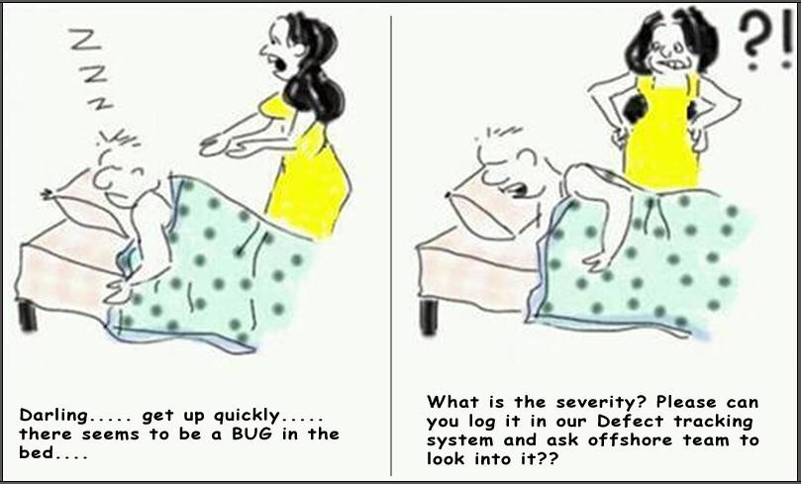
severity

Slide 7
Severity and priority
Severity-The degree of impact casted by the bug
on an application.
OR
Severity is the seriousness of the problem.
Priority-Relative degree of precedence given to a bug for its fixation.
OR
Priority is the urgency of fixing a problem.

Slide 8
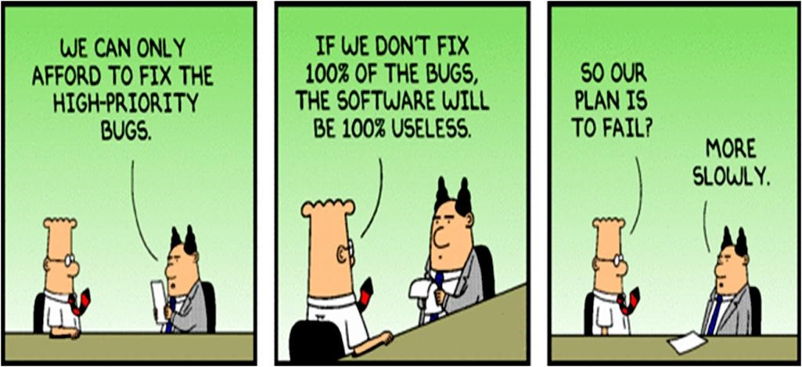
priority

Slide 9
Severity vs priority
Severity
impact of a failure caused by this fault
Priority
urgency to fix a fault
Examples
minor cosmetic type
System crash if this feature
is used
company name, board member: priority, not severe
Experimental, not needed yet:
severe, not priority

Slide 10
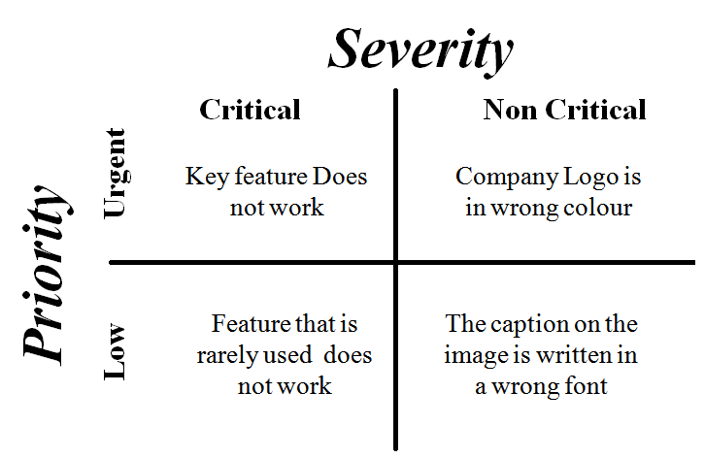
Severity and priority table

Slide 11
Difference between defect severity and priority
Defect Priority | Defect Severity
1. Priority defines the order in which the developer should resolve a defect | 1. It is defined as the degree of impact that a defect has on the operation of the product
2. Priority is categorized into three types Low Medium High | 2. Severity are categorized into five types Critical Major Moderate Minor Cosmetic
3. Priority indicates how soon the bug should be fixed | 3. Severity indicates the seriousness of the defect on the product functionality

Slide 12
Difference between Defect Priority
and Defect Severity conti..
Defect Priority | Defect Severity
4.Priority status is based on the customer requirements | 4.Severity status is based on the technical aspect of the product
5.Priority is driven by business value. | 5.Severity is driven by functionality
6.Priority of defects is decided in consultation with the manager/client. | 6.QA engineer determines the severity level of the defect.
7.High priority and low severity status indicates, defect have to be fixed on immediate basis but does not affect the application | 7.High severity and low priority status indicates defect have to be fixed but not on immediate basis

Slide 13
Examples of defect severity and priority
High severity and high priority System crashes in Log-in Page
High severity and Low priority System crashes on clicking a button.
The page on which the button is located is a part
of next release.
Low severity and high priority
Spelling mistake in any company name web site.
Low severity and Low priority
Location of button in any web based application

Slide 14
Defect report template
Defect identifier=def_login_001
Defect summary=
Test Id-
Test case name-
Module name- login
Reproducible- step to be followed from test cases
Severity-high/medium/low
Priority-high/medium/low
Raised by-Tester name
Assigned to- TL(name)
Date of assignment-
Status=open
Snap shots
Fixed by=developer name
Date of fixing=
Approvals=manager name

Slide 15
Defect template
(By testers)
Defect ID: Unique number or name
Description: The summary of the defect
Build version number: The version number of current build, in which test engineers detected this defect.
Feature: The name of module or functionality
Test Case Name: The name of failed test case

Slide 16
Defect template
Reproducible: Yes/No
(Yes – if the defect appears every time during test
execution : attach test procedure or script)
(No – if the defect rarely appears during test
execution : attach strong reasons and snap shot)

Slide 17
Defect template
Severity in terms of functionality.
HIGH/SHOWTOPPER Important & Urgent. Mandatory to resolve & Unable to continue testing without resolving.
MEDIUM/CRITICAL Important but not urgent. Mandatory to resolve but able to continue testing.
LOW/NONCRITICAL Not Important & Not urgent. May or may not resolve but able to continue testing.

Slide 18
Defect template
Priority: The Importance of the defect to be resolved with respect to the customer (HIGH/MEDIUM/LOW)
Status: New/Re-open
New: Reporting first time
Re-Open: Reporting same defect
Reported by: Name of the Tester
Reported on: Date and time of defect reporting

Slide 19
Defect template
Assigned To: The responsible person at development side to receive this defect
Suggest fix :( Optional): Reasons to accept and
restore these defect.

Slide 20
Defect template
(By Developers)
Fixed by: Project Manager or Team Leader
Resolved by: Name of programmer
Resolution Type: Accepted, rejected, or postponed
Resolved on: Date of resolving
Approved by: Signature of project Manager

Slide 21
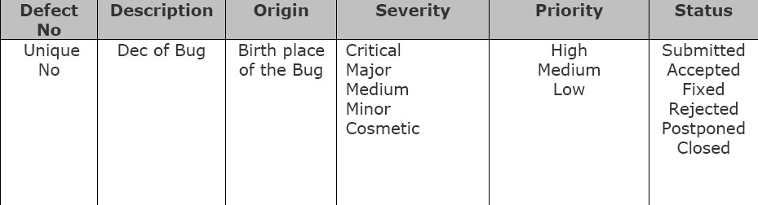
Defect tracking sheet

Slide 22
Defect management
Primary goal is to prevent defects
Should be integral part of development process
As much as possible should be automated
Defect information should be used for process
improvements

Slide 23
Defect management
Defect Prevention
Deliverable Baseline
Defect Discovery
Defect Resolution
Process Improvement
Management Reporting

Slide 24
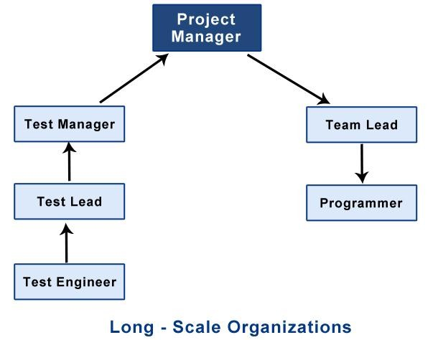
Defect submission

Slide 25
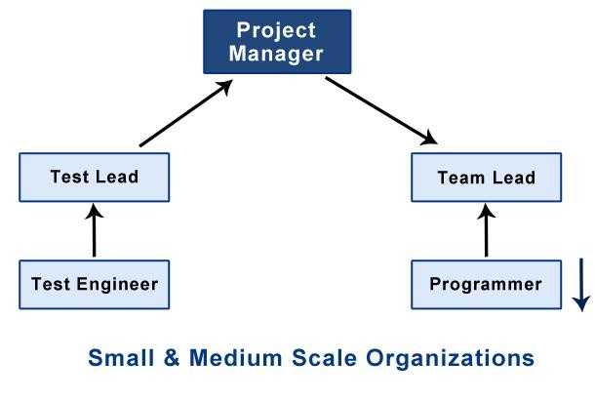
Defect submission

Slide 26
Defect submission
In the above defect submission process, testing team uses defect tracking software.
E.g.: Test Director, Bugzilla, ALM(application
lifecycle managment )…etc.

Slide 27

Defect life cycle
New
Next Release
Open
Assign
Deferred
Reject
Re-open
Fixed
Duplicate
Re-testing
Verify
Closed

Slide 28
Defect life cycle
New : Tester found new bug and reports it to test lead.
Open : Team lead open this bug and assign it to the developer.
Assign : Developer has three choices after assigning the bug
Reject :He can say that this is not a bug because of some hardware or other problems you might getting defect in application.
Differed : He can postpone bug fixing according to
priority of bug
Duplicate : If the bug is repeated twice or the two bugs mention the same concept of the bug, then one bug status is changed to “DUPLICATE”.
Fixed : If there are no such conditions like reject,
duplicate the developer has to fix the bug.

Slide 29
Defect life cycle
Re-testing : Re-test the whole application to find the defects if the defect is still there.
In case there is a bug present, they will re-open the bug and if bug is not there it will move to verify.
Re-open : If defect raised during re-testing we re- open bug.
Verify : Test whole application(Regression).
Close : Close the defect.

Slide 30
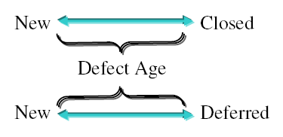
What is defect age
Time gap between defect reporting & defect
closing or deferring.

Slide 31
Defect density
The average no. of defects found in a module or
function is called defect density.

Slide 32
Types of defects
User interface defects
Spelling mistakes
Invalid label of object w.r.t functionality
Improper right alignment
Error handling defects
Error message not coming for wrong
operation
Wrong error message is coming for wrong
operation
Correct error message but incomplete
Input domain defects
Does not take valid input
Taking valid and invalid also
Taking valid type but the range is exceeded

Slide 33
Types of defects
Manipulations defects
Wrong output
Valid output without having decimal points Valid output with rounded decimal points EX: actual answer is 10.96
High (13), medium (10) and low (10.9)
Race conditions defects Hang or dead lock
Invalid order of functionalities Application build is running on some of
platforms only

Slide 34
Types of defects
H/W related defects
Device is not connecting
Device is connecting but returning wrong output
Device is connecting and returning correct output but incomplete
Load condition defects
Does not allow customer expected load
Allow customer expected load on some of the
functionalities
Allowing customer expected load on all functionalities w.r.t benchmarks

Slide 35
Types of defects
Source defects
Wrong help document
Incomplete help document
Correct and complete help but complex to understand
ID control defects
Logo missing, wrong logo, version number missing, copy right window missing, team members name missing

Slide 36
Interview questions
What is the difference between Defect
Severity and Priority ?
What is the key difference between Error , Defect and failure ?
What is deferred defect?
How defects are prioritized?
What is a reproducible defect?
Explain the Defect Life Cycle.
What is Defect Density?

Slide 37

Any questions?

